Slide 1

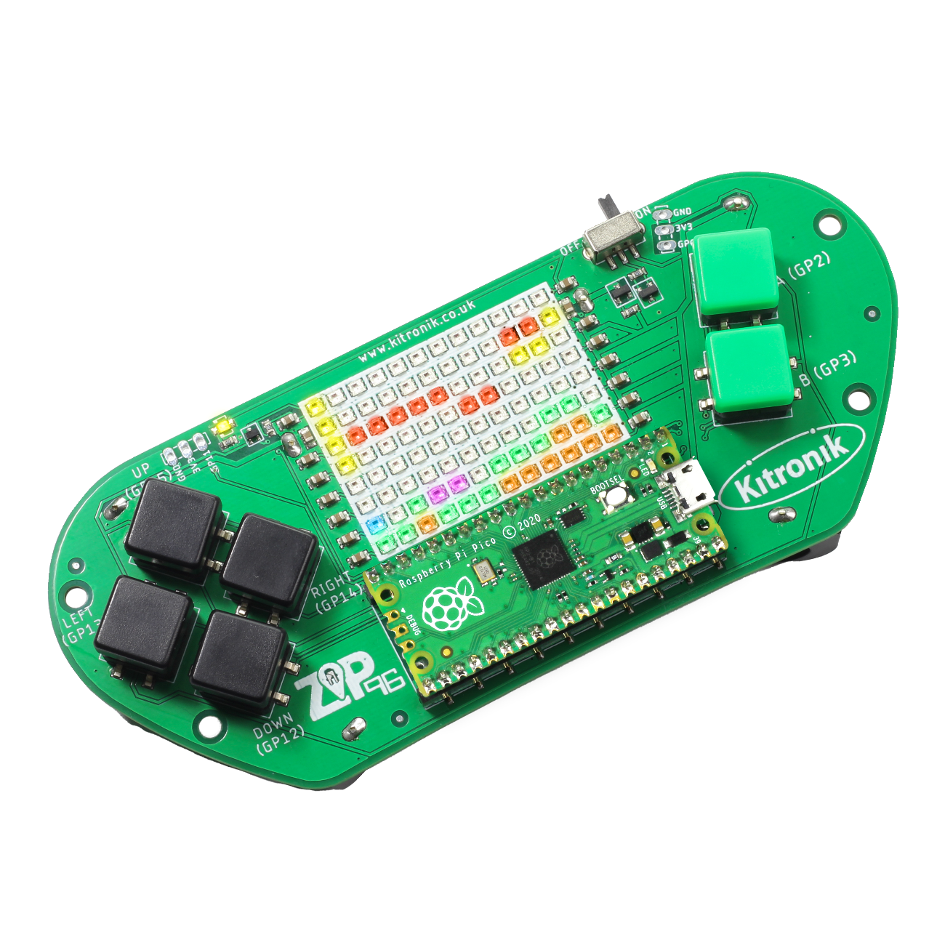
creating the a-mazing game
Computer Science

Slide 2

Aims & objectives
Computer Science
By the end of this lesson you will have:
Defined the ‘Gem’ class.
Added Gem objects to the maze structure.
Tested collecting Gems by moving the player around the maze.

Slide 3
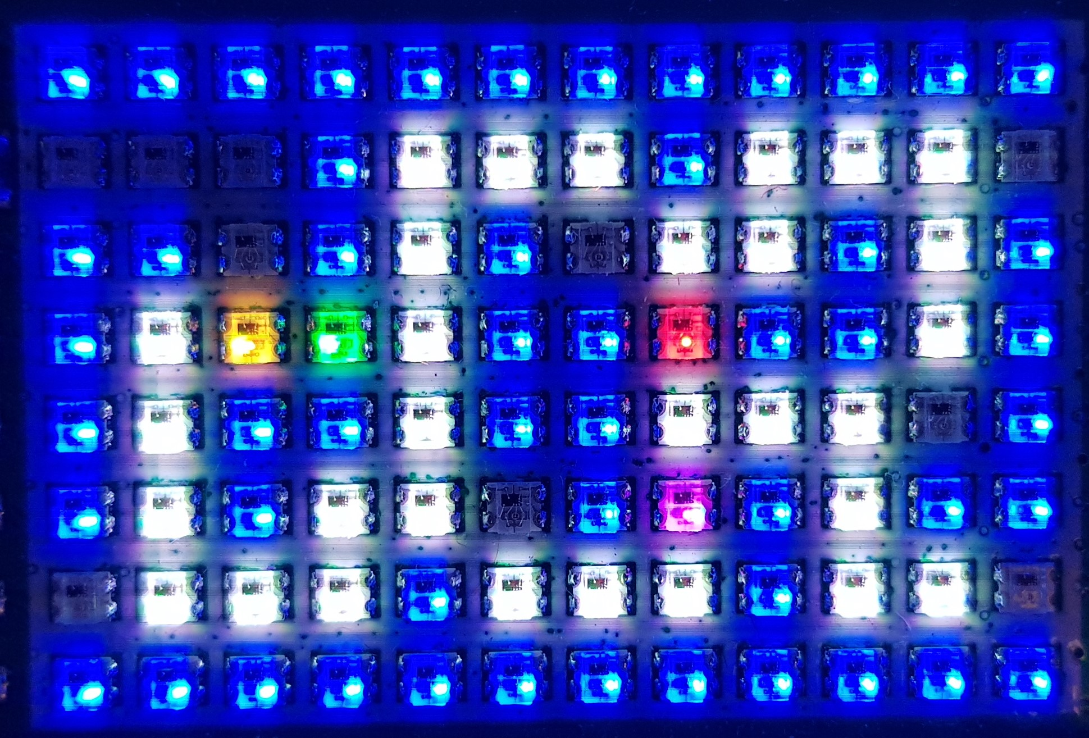
What is our a-mazing game?
Computer Science
A maze-based game where the player runs through a maze collecting gems – collect all the gems to win.
Three different enemies move around the maze as well, trying to stop the player from collecting gems.
One enemy moves randomly, one simply tries to move towards the player, the final one is smart and finds the best path through the maze to the player.
If an enemy catches the player, they lose a life. Once all three lives are lost… game over!

Slide 4
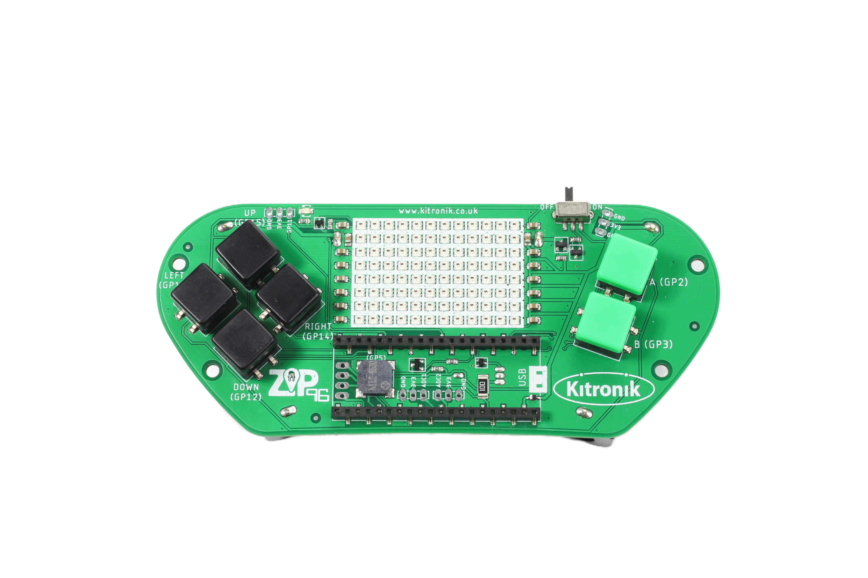
Thonny setup
Computer Science
Connect Pico ZIP96 to computer using a USB cable and open Thonny.

Slide 5
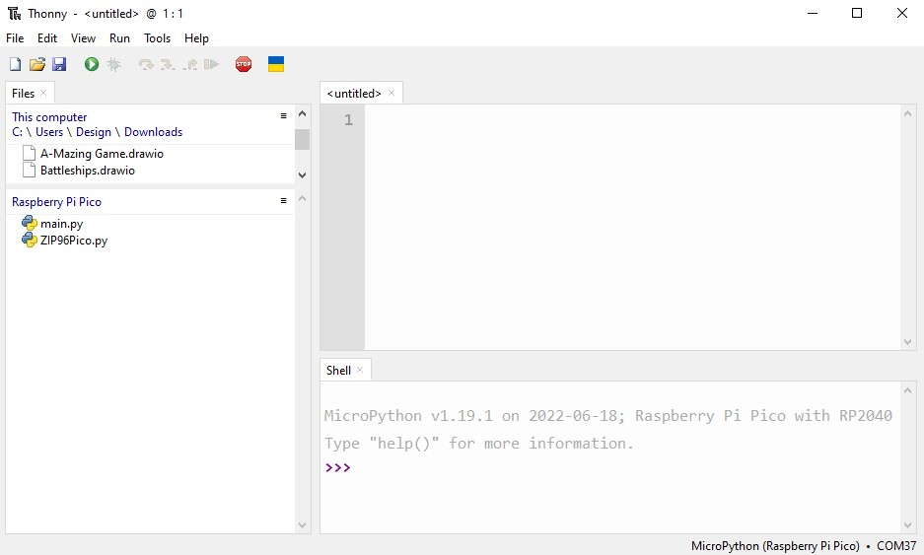
Thonny setup
Computer Science
Check the Pico device appears in the bottom right corner of Thonny.
Try pressing STOP if it does not appear automatically.
Turn on the ‘Shell’ by going to ‘View > Shell’.

Slide 6
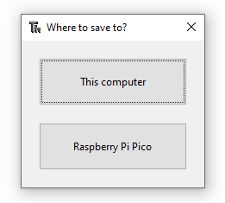
Thonny setup
Computer Science
Create a new file by clicking ‘File > New’.
Save it to the Pico by clicking ‘File > Save as’ and then select ‘Raspberry Pi Pico’.
Name the file ‘main.py’.

Slide 7
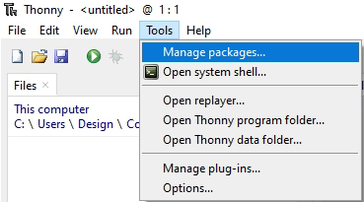
Thonny setup
Computer Science
Install the ‘ZIP96Pico’ library onto the Pico.
Click on ‘Tools > Manage Packages…’

Slide 8
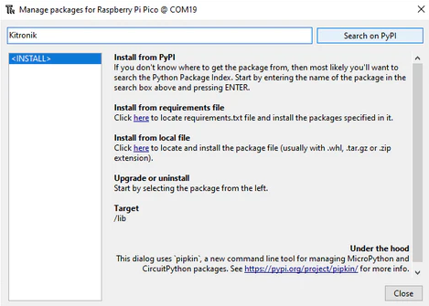
Thonny Setup
Computer Science
With the ‘Manage packages’ window open, search for ‘Kitronik’ and click the ‘Search on PyPI’ button.
Locate ‘KitronikPicoZIP96’ in the list of search results, then click the ‘Install’ button.
Confirm the install by clicking ‘Yes’ if prompted by Thonny.

Slide 9
Defining the gem class
Computer Science
What information will the Gem class need to store?
The Gem constructor will need:
its x and y position on the screen,
the colour used for the its LED,
the screen object to draw the gem on the ZIP96.

Slide 10

Defining the gem class
Computer Science
The gems in the maze need to be collected by the player. How will the program know whether a gem is collected or not? What method could be used, and what difference should a gem being collected or not make to the game setup?

Slide 11
Coding: Gem class
Computer Science
After the Wall class, define the Gem class:
# Class to store our Gem functionality
class Gem():
# Gem object constructor
def __init__(self, x, y, colour, screen):
self.x = x
self.y = y
self.colour = colour
self.screen = screen
self.collected = False
# Draw the starting position
self.draw()

Slide 12
Coding: draw gems & check collisions
Computer Science
After the Gem class constructor, define a new function:
# Draw the current position on the screen
def draw(self):
# Only draw as a Gem if it hasn't been collected
if self.collected:
self.screen.setLEDMatrix(self.x, self.y, screen.BLACK)
else:
self.screen.setLEDMatrix(self.x, self.y, self.colour)
# Check if the given x and y are the same as our current position
def collision(self, x, y):
return self.x == x and self.y == y

Slide 13
Coding: gem coordinate array
Computer Science
After the walls array ‘for’ loop:
# List to store the coordinates of our gems
gemsXY = [(1, 1), (2, 1), (4, 1), (5, 1), (6, 1), (8, 1), (9, 1), (10, 1),
(2, 2), (4, 2), (7, 2), (8, 2), (10, 2),
(1, 3), (2, 3), (3, 3), (4, 3), (7, 3), (10, 3),
(1, 4), (4, 4), (7, 4), (8, 4), (9, 4),
(1, 5), (3, 5), (4, 5), (7, 5), (9, 5),
(1, 6), (2, 6), (3, 6), (5, 6), (6, 6), (7, 6), (9, 6), (10, 6)]

Slide 14
Coding: gem object array
Computer Science
After the gem coordinates array:
# List to store our Gem objects
gems = []
# Loop to create Gem objects using the gemsXY coordinates
for gemXY in gemsXY:
# Add the Gem objects to our gems list
gems.append(Gem(gemXY[0], gemXY[1], gamer.Screen.WHITE, screen))

Slide 15
Coding: add gems to player class
Computer Science
In the Player constructor:
def __init__(self, x, y, colour, walls, gems, screen, screenWidth, screenHeight):
self.x = x
self.y = y
self.colour = colour
self.walls = walls
self.gems = gems
self.foundGems = 0

Slide 16
Coding: dealing with collisions
Computer Science
Just before draw() in the move() function in the Player class:
# Check each Gem in our list
for gem in self.gems:
# If the Player is colliding with a Gem
if gem.collision(self.x, self.y):
# If the Gem hasn't been collected
if not gem.collected:
# Collect the Gem
gem.collected = True
self.foundGems += 1
# Cannot collide with more than one Gem so leave loop
break

Slide 17
Coding: include gems in player object
Computer Science
Update player object to include ‘gems’ as a parameter:
# Create an object for our player
player = Player(0, 1, gamer.Screen.YELLOW, walls, gems, screen, screenWidth, screenHeight)
Run the program to test the gem placement in the maze and try collecting them

Slide 18
Coding: include gems in player object
Computer Science
What happens when all of the gem objects have been collected?

Slide 19
conclusion
Computer Science
In this lesson you have:
Created the ‘Gem’ class, it’s constructor and methods.
Used a for loop, if statement and Boolean logic to check for interaction between Player and Gem objects.

